Slide 1
Equipment identification through image recognition
Darkhan’s Master thesis
Biweekly report
Literature review

Slide 2
Contents
UDA methods
Unsupervised Domain Adaptative Object Detection
Pseudo-label self training
Image-to-Image translation
Domain randomization
Graph reasoning
Mean teacher training
Adversarial feature learning
Domain adaptive Faster-RCNN for object detection in the wild, 2018
A Robust Learning Approach to Domain Adaptive Object Detection, 2019
Progressive Domain Adaptation for Object Detection, 2019
A Domain Adaptive Representation Learning Paradigm for Object Detection, 2019
Exploring Object Relation in Mean Teacher for Cross-Domain Detection, 2019
Cross-domain adaptive teacher for object detection, 2021
Unsupervised Domain Adaptation of Object Detectors: A Survey, 2021
A Survey of Unsupervised Domain Adaptation for Visual Recognition, 2021
Deep Visual Domain Adaptation: A Survey, 2018
Notes:
According to the papers referenced, the UDA methods can be categorized into the following 6 categories.
Adversarial-based: these methods identify the domain invariant features via two competing networks.
Pseudo-labeling-based: these methods generate pseudo labels for the target domain to reduce the domain divergence.
Image to Image translation: utilizes an unpaired image translation model to translate target image to a source-like image or vice versa.
Domain randomization: creates multiple stylized version of source domain data to train the detector model such that the model is not biased towards any one style and generalizes better on the target domain.
Graph reasoning: exploits the inter-object and intra-object relationships that exist in detection dataset. These object relations are modeled through graphs
Mean Teacher training: progressively training a detector model in a student-teacher framework.
For each of the categories I present one paper that uses that method, with the exception of 5 and 6, which are combined in one study.

Slide 3
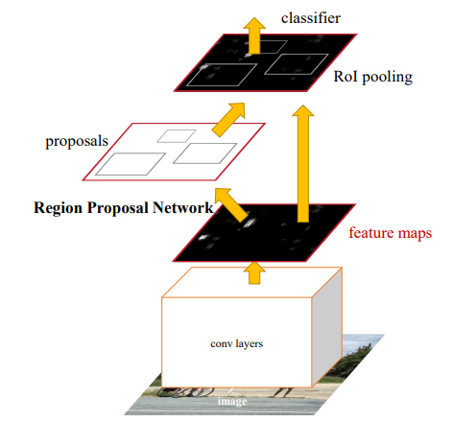
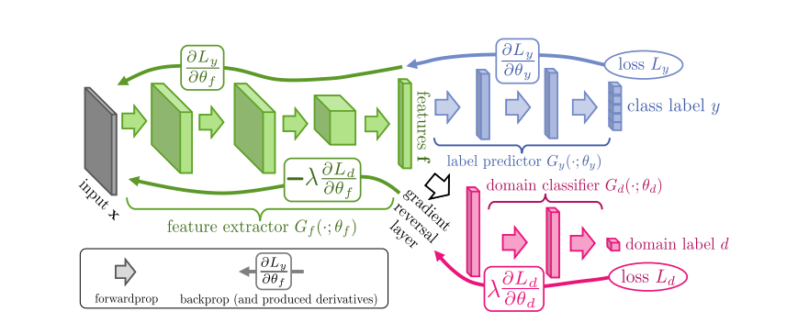
Gradient reversal layer (GRL)
Unsupervised Domain Adaptative Object Detection
Adversarial feature learning
Gradient reversal layer (GRL)
Source: Domain-Adversarial Training of Neural Networks, 2016
Source: Faster R-CNN: Towards Real-Time Object Detection with Region Proposal Networks, 2016
Notes:
Typical two stage detector such as Faster RCNN uses a Region Proposal Network and a classifier based on the regions proposed.
The goal in a domain adaptation scenario is to reduce this distance, i.e., increase the domain classifier error.
The overall goal is to achieve a domain invariant feature space of a backbone neural network with the help of a neural network-based domain classifier.
The paper on the left proposes to utilize a GRL, which is placed after the feature maps are extracted. On the forward loop nothing happens, however, on the backpropagation loop the gradient of domain classifier loss is multiplied by -1. This allows us to learn domain invariant features and pass it to label classifier.

Slide 4
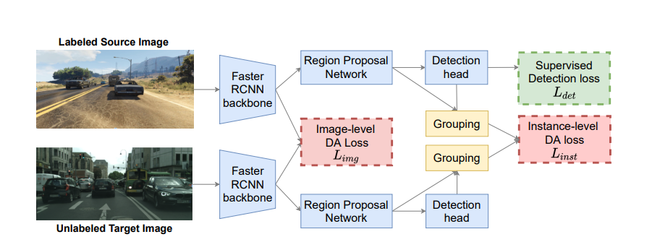
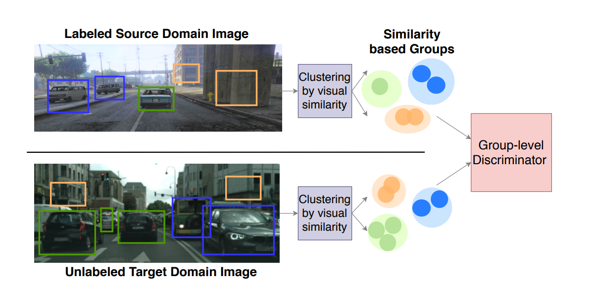
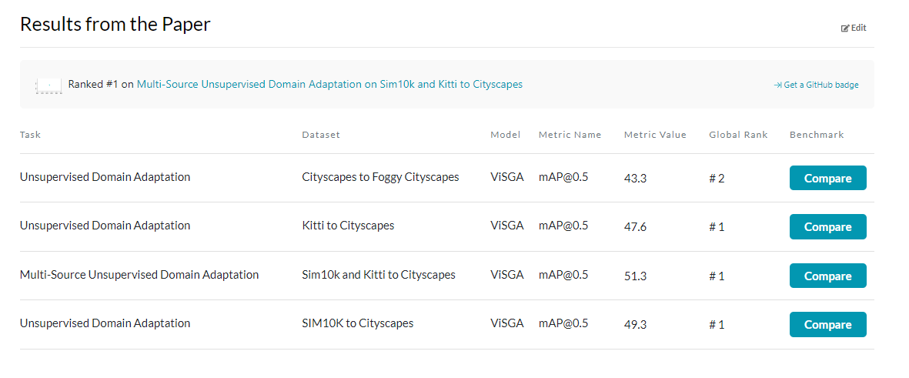
Similarity-based Domain Alignment for Adaptive Object Detection
Unsupervised Domain Adaptative Object Detection
Adversarial feature learning
Similarity-based Domain Alignment for Adaptive Object Detection, 2021
AT vs CL
GRL
Source: VisGA, Similarity-based Domain Alignment for Adaptive Object Detection, 2021
Notes:
There are two reasons for picking this paper as an example. First, it achieves very good results on common datasets. Additionally, it compares the Adversarial training to the method in the paper that you suggested earlier (https://arxiv.org/abs/2106.05528)
Adversarial and contrastive learning
The main idea in max margin contrastive loss is to push features from the same class closer and push apart features belonging to different classes across domains.
(It essentially equates the Euclidean distance between them if they have the same label (y_i=y_j) and is otherwise equivalent to hinge loss)
In the paper Adversarial training performed better than contrastive learning, therefore the authors proceeded with AT.
Starting bottom-up, each proposal is considered as an individual cluster.
Then, at each step, the two closest clusters according to a distance metric are merged together.
They utilize cosine distance as our merging metric

Slide 5
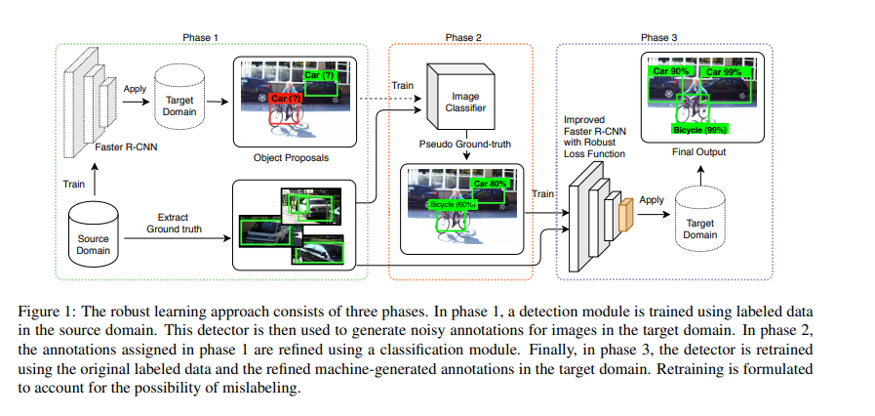
A Robust Learning Approach to Domain Adaptive Object Detection
Unsupervised Domain Adaptative Object Detection
Pseudo labeling based methods
A Robust Learning Approach to Domain Adaptive Object Detection, 2019
Maximum likelihood loss:
Source: A Robust Learning Approach to Domain Adaptive Object Detection, 2019
Notes:
Figure 1: The robust learning approach consists of three phases.
In phase 1, a detection module is trained using labeled data in the source domain.
This detector is then used to generate noisy annotations for images in the target domain.
In phase 2, the annotations assigned in phase 1 are refined using a classification module.
Finally, in phase 3, the detector is retrained using the original labeled data and the refined machine-generated annotations in the target domain.
Retraining is formulated to account for the possibility of mislabeling.
We seek a distribution, q(yc), which is close to both the classification model of Faster R-CNN and the image classification model p img, that is trained in phase two.
The label (yc) and the box location/size (yl)
Kullback-Leibler Divergence
https://machinelearningmastery.com/divergence-between-probability-distributions/
where α is a hyper-parameter that controls the trade-off between the two terms. α starts with a large value and it is gradually decreased to smaller values as the third phase training progresses

Slide 6
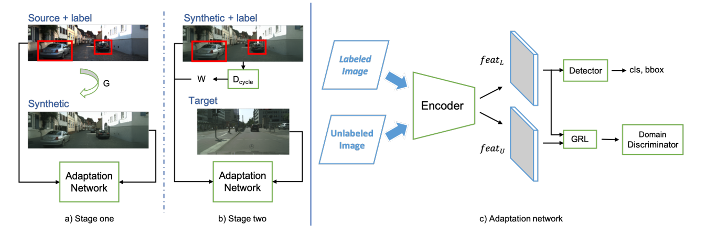
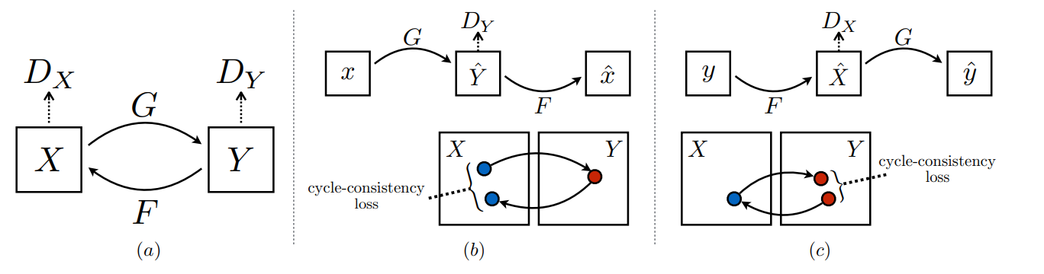
Progressive Domain Adaptation for Object Detection
Unsupervised Domain Adaptative Object Detection
Image to Image translation
Progressive Domain Adaptation for Object Detection, 2019
CycleGAN
Unpaired Image-to-Image Translation using Cycle-Consistent Adversarial Networks , 2017
Source: Progressive Domain Adaptation for Object Detection, 2019
Notes:
The proposed progressive adaptation framework. The algorithm includes two stages of adaptation as shown in a) and b). In a), we first transform source images to generate synthetic ones by using the generator G learned via CycleGAN [36].
Afterward, we use the labeled source domain and perform first stage adaptation to the synthetic domain.
Then in b), our model applies a second stage adaptation which takes the synthetic domain with labels inherited from the source and aligns the synthetic domain features with the target distribution.
In addition, a weight w is obtained from the discriminator Dcycle in CycleGAN to balance the synthetic image qualities in the detection loss.
The overall structure of our adaptation network is shown in c). Labeled and unlabeled images are both passed through the encoder network E to extract CNN features featL and featU .
We then use them to: 1) learn supervised object detection with the detector network from featL, and 2) forward both features to GRL and a domain discriminator, learning domain-invariant features in an adversarial manner.
Cross-entropy loss, or log loss, measures the performance of a classification model whose output is a probability value between 0 and 1. Cross-entropy loss increases as the predicted probability diverges from the actual label.

Slide 7
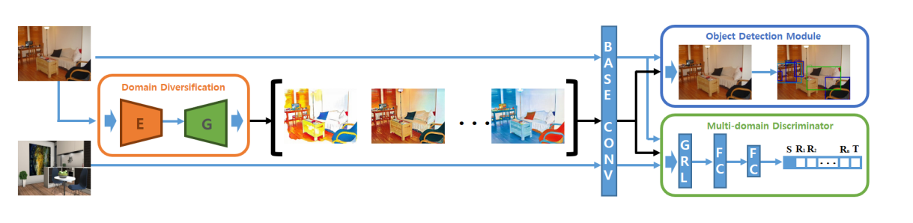
A Domain Adaptive Representation Learning Paradigm for Object Detection
Unsupervised Domain Adaptative Object Detection
Domain randomization
A Domain Adaptive Representation Learning Paradigm for Object Detection, 2019
CycleGAN
Unpaired Image-to-Image Translation using Cycle-Consistent Adversarial Networks , 2017
Source: Diversify and Match: A Domain Adaptive Representation Learning Paradigm, 2019
Notes:
To distinctively shift the source domain, we consider two factors in the objective function, i.e., color preservation and reconstruction.
Color preservation loss (on average the color diversity should be the same)
Inverse translation loss

Slide 8
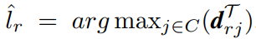
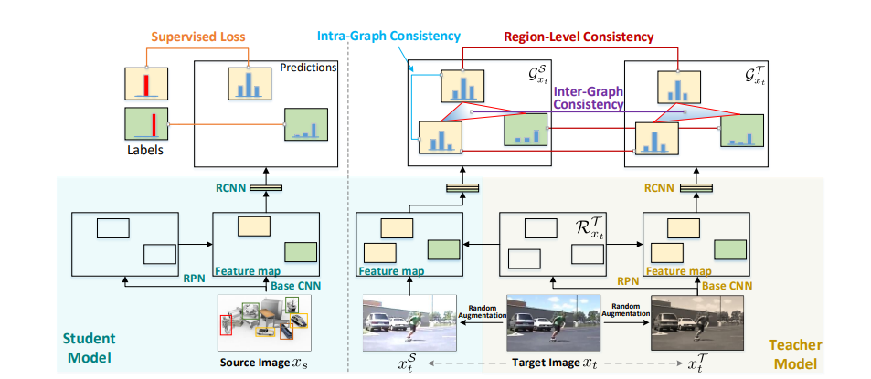
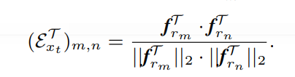
Exploring Object Relation in Mean Teacher for Cross-Domain Detection
Unsupervised Domain Adaptative Object Detection
Mean teacher training + Graph reasoning
Exploring Object Relation in Mean Teacher for Cross-Domain Detection, 2019
Pseudo labels:
Cosine similarity
Source: Exploring Object Relation in Mean Teacher for Cross-Domain Detection, 2019
Notes:
With the inputs of two different augmentations for the same unlabeled sample, teacher and student models should produce similar predicted probabilities.
We are treating each region in teacher/student as one vertex and obtaining the affinity matrix whose entry measures the similarities between every two regions.
three consistency regularizations:
1) region-level consistency to align the region-level predictions of the vertices in teacher and student graphs sharing the same spatial location – Average RMS(E_teach, E_stud)
2) inter-graph consistency for matching the graph structures (i.e., the affinity matrices) of teacher and student graphs – Average RMS(aff_teach, aff_stud)
3) intra-graph consistency to enhance the similarity between regions belonging to the same class within the graph of student.

Slide 9

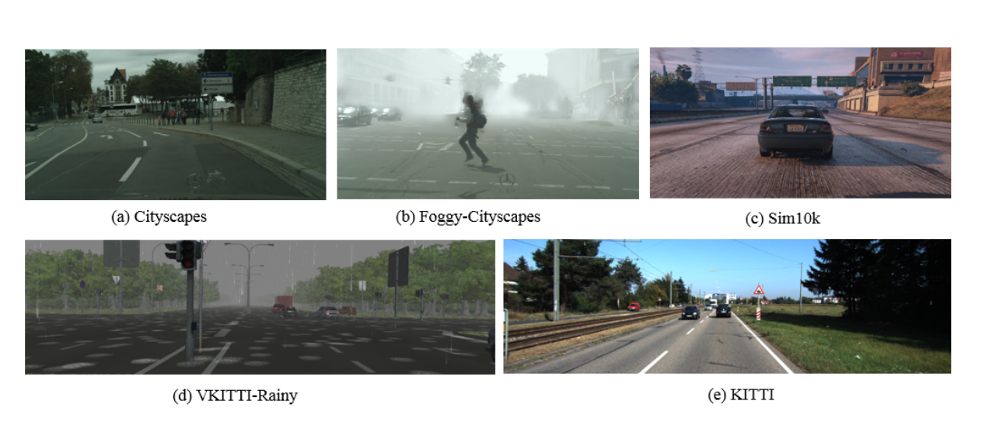
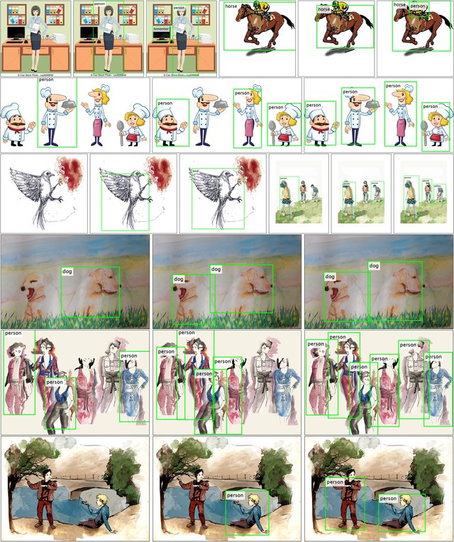
Research directions proposed by the survey
Complex real-world datasets and considering other applications
Common applications:
Autonomous driving
Drawings
Day-to-day objects
No industrial applications
Based on: Unsupervised Domain Adaptation of Object Detectors: A Survey, 2021

Slide 10
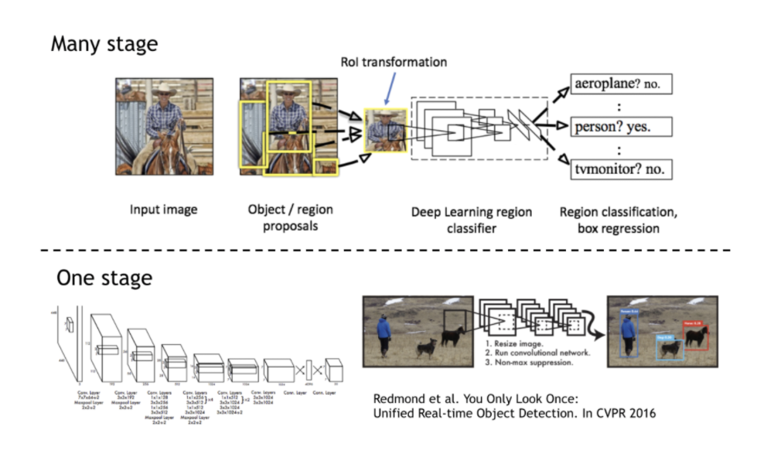
Research directions proposed by the survey
Generalizing to other detection frameworks
Object detection frameworks
Two-stage detectors
One-stage detectors
Faster RCNN (2015)
Mask R-CNN (2017)
SSD (2016)
YOLOR (2021)
FCOS
DETR
YOLO:
Domain Adaptive YOLO for One-Stage Cross-Domain Detection, 2021
Multiscale domain adaptive yolo for cross-domain object detection, 2022
FCOS: Attention-based Domain Adaptation for Single Stage Detectors, 2021
DETR: DA-DETR: Domain Adaptive Detection Transformer by Hybrid Attention
Based on: Unsupervised Domain Adaptation of Object Detectors: A Survey, 2021
Notes:
Faster RCNN is a de facto object detection framework in domain adaptation applications.
Only a few examples use one stage detectors.

Slide 11
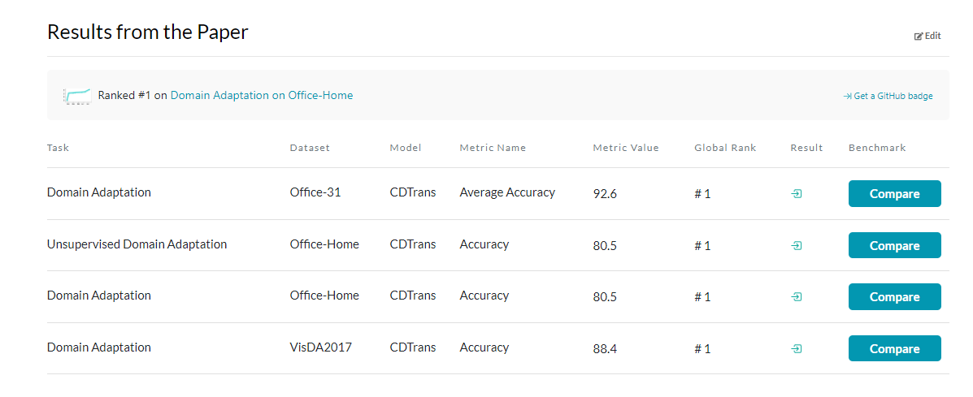
Research directions proposed by the survey
Domain adaptation in image classifiers
DA in classification problems:
CDTrans: Cross-domain Transformer for Unsupervised Domain Adaptation, 2022
Implicit Class-Conditioned Domain Alignment for Unsupervised Domain Adaptation, 2020
FixBi: Bridging Domain Spaces for Unsupervised Domain Adaptation, 2021
On Evolving Attention Towards Domain Adaptation, 2021
Domain generalization:
Domain Generalization by Mutual-Information Regularization with Pre-trained Models, 2022
Motivation:

Slide 12
Research directions proposed by the survey
Others
Weak/semi-supervised domain adaptation(Not relevant to our case study)
Leverage from annotations for a smaller subset of images in a target dataset
Imbalanced classes (Not relevant to our case study)
To develop methods that estimate the class distribution in the target dataset and reevaluate the weights
Partial domain adaptation (Not relevant to our case study)
Target dataset has fewer classes than the ones in the source dataset
Open-set domain adaptation (Not relevant to our case study)
Target domain contains unknown classes that are not observed in the source domain
Source-free domain adaptation (Not relevant to our case study)
Source dataset is not available, but the model is
Multi-source domain adaptation (Not relevant to our case study)
Continuous and test time adaptation
Gradually changing lighting/weather conditions
Based on: Unsupervised Domain Adaptation of Object Detectors: A Survey, 2021
Notes:
In theory, the final dataset of equipment pictures will be with a fixed size of source and target images, as well as the number of labels annotated. Class distribution will also be of a fixed size.
Only thing here that might be relevant to us is that the environment of the real pictures is changing due to different lighting, weather etc. Therefore, continuous and test time adaptation sounds relevant to our case.

Slide 13
Other promising papers to consider
Domain adaptation of object detectors
By absolute mAP:
By ∆mAP:
Alternatives: Self-Adversarial Disentangling for Specific Domain Adaptation
Method | CS → F | S10K → CS | KI → CS | CS → KI | VOC → Clip | VOC → WC | VOC → Comic | CS → BDD | Framework | LR | Additional Comments | Average | Datasets tested | Method type
Memory-guided category-wise adaptation 2021 | 41.8 | 44.8 | 43 | 75.5 | - | - | - | - | FRCNN | 0.002 | SS: 600, Epochs: 10 | 51.275 | 4 | Adv.
Spatial attention pyramid network 2020 | 40.9 | 44.9 | 43.4 | 75.2 | 42.2 | 55.2 | - | - | FRCNN | 0.00001 | SS: 600, Iter: 90K | 50.3 | 6 | Adv.
Robust learning from noisy labels 2020 | 36.4 | 42.5 | 42.9 | 77.6 | - | - | - | - | FRCNN | 0.001 | SS: 600 | 49.85 | 4 | Pseudo.
Adaptive transformer-based detector 2021 | 43.5 | 55.3 | - | - | - | - | - | - | DETR | 0.0002 | Epochs: 50 | 49.4 | 2 | Adv.A
Method | CS → F | S10K → CS | KI → CS | CS → KI | VOC → Clip | VOC → WC | VOC → Comic | CS → BDD | Framework | LR | Additional Comments | Average ∆ | Datasets tested | Method type
Every pixel matters 2020 | 17.2 | 18.9 | 13 | - | - | - | - | - | FCOS | 0.005 | SS: 800, Epochs: 10 | 16.36667 | 3 | Adv.
Memory-guided category-wise adaptation 2021 | 17.4 | 10.5 | 12.8 | 22 | - | - | - | - | FRCNN | 0.002 | SS: 600, Epochs: 10 | 15.675 | 4 | Adv.
Spatial attention pyramid network 2020 | 17.6 | 10.3 | 13.2 | 21.7 | 14.4 | 10.6 | - | - | FRCNN | 0.00001 | SS: 600, Iter: 90K | 14.63333 | 6 | Adv.
Based on: Unsupervised Domain Adaptation of Object Detectors: A Survey, 2021

Slide 14
Last thoughts
Ideas to consider
In my paper, I propose to further study domain adaptation, and consider adversarial adaptation as it seems to be the most dominant one in the benchmarks.
I propose several options:
Attempt to reimplement [1], but with single shot detector as a backbone
Use additional loss term
Any other options are more than welcome..
Notes:
Convert one of the top performing implementations of Domain
Adaptation in classification problems [2] on object detection problem by running it after the Region Proposal Network of Faster RCNN.

Slide 15
My method
Use single shot detector as a base like in Multiscale domain adaptive yolo for cross-domain object detection, 2022
Use pseudo labeling like in A Robust Learning Approach to Domain Adaptive Object Detection, 2019
Use Similarity-based clustering like in Similarity-based Domain Alignment for Adaptive Object Detection, 2021
Use additional loss term which is better for single shot detectors(proof: https://arxiv.org/pdf/2201.02593v1.pdf) like here: Strong-Weak Distribution Alignment for Adaptive Object Detection, Generalized Focal Loss
Also could try InfoNCE loss (not studied yet)

Slide 16
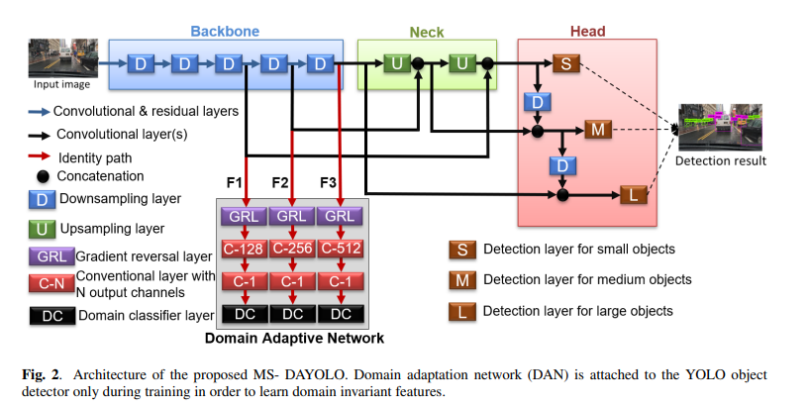
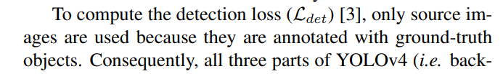
Proposed method architecture
Modified one-stage detector
Source:MULTISCALE DOMAIN ADAPTIVE YOLO FOR CROSS-DOMAIN OBJECT DETECTION, 2022

Slide 17
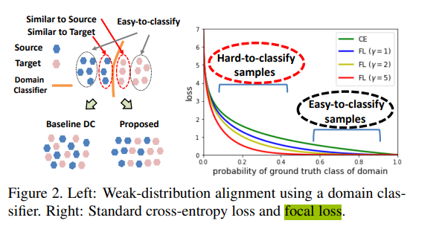
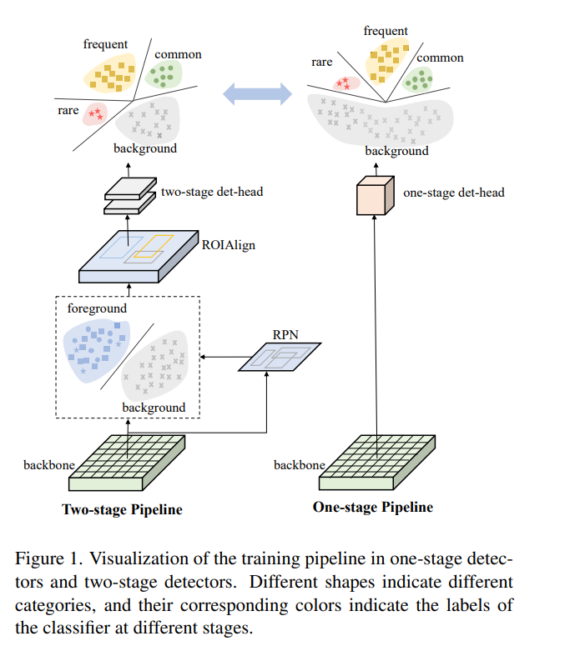
Proposed method architecture
Equalized Focal Loss
Source: Strong-Weak Distribution Alignment for Adaptive Object Detection, 2019
Source: Equalized Focal Loss for Dense Long-Tailed Object Detection , 2022

Slide 18
https://hal.archives-ouvertes.fr/hal-01869779v2/document
https://arxiv.org/pdf/2203.06398.pdf
https://web.eecs.umich.edu/~justincj/teaching/eecs442/projects/WI2021/pdfs/048.pdf
https://paperswithcode.com/search?q=author%3APetru+Soviany

Slide 19
Some code can be taken from here:
krumo/Domain-Adaptive-Faster-RCNN-PyTorch: Domain Adaptive Faster R-CNN in PyTorch (github.com)
He-Zhenwei/ATF: The code of our ECCV paper: Domain Adaptive Object Detection via Asymmetric Tri-way Faster-RCNN (github.com)
ashkamath/mdetr (github.com)

Slide 20
YOLO
Some code can be taken from here:
https://github.com/Tianxiaomo/pytorch-YOLOv4
https://github.com/vaibhavjindal/domain-adaptation-on-yolo-tiny
https://github.com/Mazin-Hnewa/MS-DAYOLO
https://github.com/ultralytics/yolov5/wiki/Train-Custom-Data
file:///C:/Users/vansaidnda/Downloads/sensors-22-03253%20(2).pdf

Slide 21
SSD
Some code can be taken from here:
https://github.com/czzbb/I3Net
https://arxiv.org/pdf/2106.07283.pdf

Slide 22
FCOS
https://github.com/chengchunhsu/EveryPixelMatters

Slide 23
DETR
https://github.com/encounter1997/SFA

Slide 24
Potentially:
https://github.com/facebookresearch/adaptive_teacher

